Slide 1
Group:
Erick Cuellar
Fahad Hossain
Taylor Klis
Kristopher Lavigne
Brandon Tout
Hanqi Yin
“Capturing the moments that matter”

Slide 2
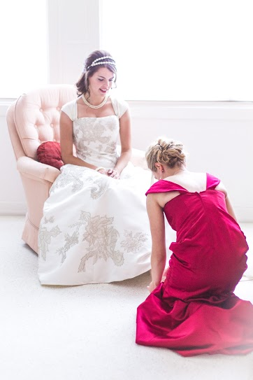
What is Pivison Photgraphy?
Fahad is the business owner
Sole proprietorship
Started up in 2013
Once a hobby, now a small business
Caters to many difference events such as: weddings, concert, senior portraits, portfolio headshots, etc.

Slide 3
Group Website

Slide 4
Access Database
We created this database based on Fahad’s photography business. Our group knew we could create business value to his sole proprietorship as everything was written on loose leaf paper. Fahad wanted a database that not only organized his customer details, but to track trends for statistical reasons, understand popular photo packages, prices, and details in reports.
Our goal:
Improve Pivison’s proceedings, consolidate data with specific demographics and allow for a statistical interpretation of customers, tracking trends, network with our clientele on a more personal level

Slide 5
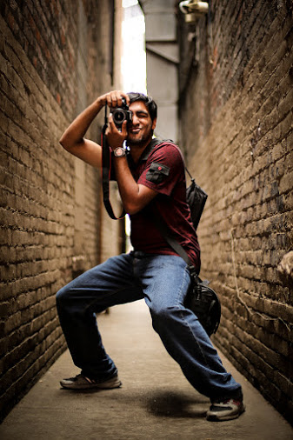
Reports in Database:
Millennial Demographic report
Season Report
Overall customer Report
Available packages Report
Referred Customer Discount Report
Report Grouped by Location

Slide 6
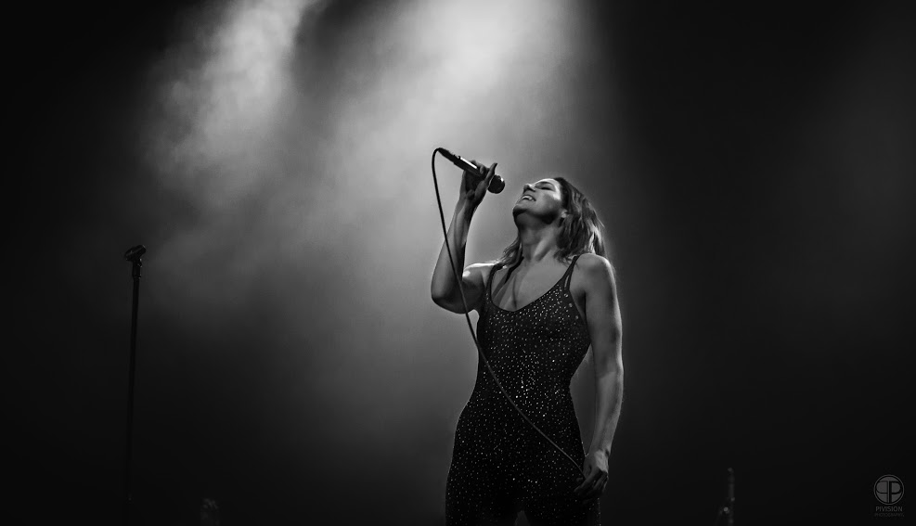
Tables
Customer
Order
Package

Slide 7
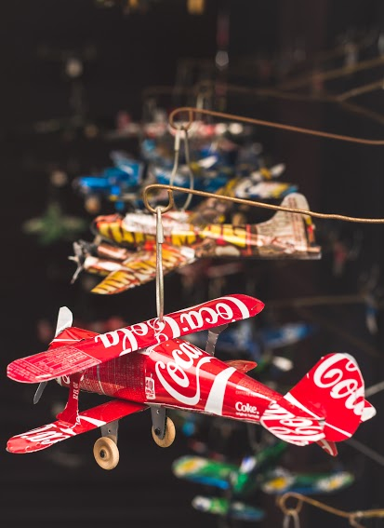
Forms:
Customer Information
Order Form
Package
Package Subform
Switchboard

Slide 8
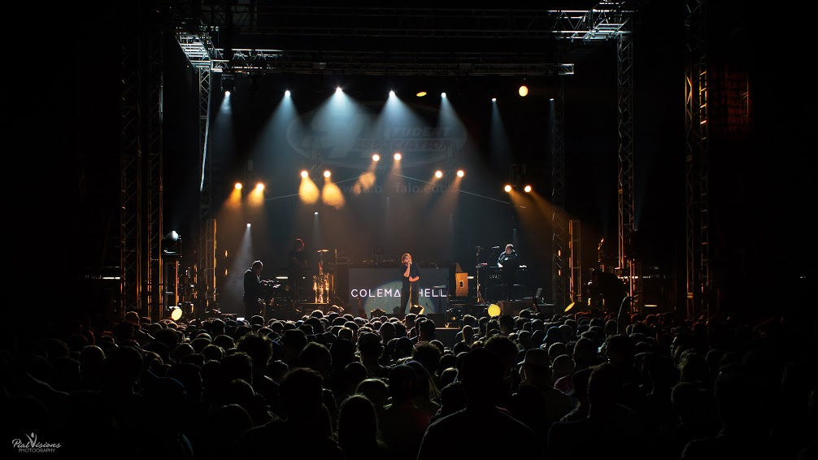
Relationships in ERD Table
One Customer to many orders OR one order to many customers
One order to many packages OR one package to many orders

Slide 9
Maintenance and Future Enhancements:
Our Database will be backed up every week
We will store the Database in a remote main frame and a cloud server linked to company email
Store on a flashdrive
Keeping Access up to date
Virus scans
Future enhancements will consist of atomizing orders, online orders linked with website, online payments, add photo album packages and inputting them in our tables/forms. We are hoping to link our database to an Photo App so customers can remotely connect with Pivison via cell phone.

